Slide 1
CSCI-SHU 210 Data Structures
Prof. Wilson Tam
Department of Computer Science
Email: yt2267@nyu.edu
Office: 1162-5, 11th Fl, Pudong Campus
Phone: +86 02120595071
Zoom: https://nyu.zoom.us/j/6743549294
Office Hours: Mon 2-4pm, Thur 1:30pm-3:30pm
Open Door Policy
Others by appointment.
Notes:
Title Change? Check website.

Slide 2
More Contacts
Yisong (Brian) Wang
Recitation Instructor and Teaching Assistants
Room No. 1162 and Email: yw6412@nyu.edu
Office hours: Wed 3-5pm, Friday 11am-1pm
Zoom: https://nyu.zoom.us/j/5683879559
Yifei (Jack) Zhang (yz7166@nyu.edu), ARC Learning Assistant
Office hours: Wed 9am-11am, Friday 1:30pm-2:30pm
Margaret Mao (wm2178@nyu.edu), ARC Learning Assistant
Office hours: Thursday 12pm-2pm
Alexander Guanwan (ag7770@nyu.edu), ARC Learning Assistant
Office hours: Tuesday 1pm-3pm
Sihang Xu
Grader
Email: sx2208@nyu.edu

Slide 3
More Contacts
Brightspace.nyu.edu (Formal)
Please enable email notifications.
Brightspace Forum (Group Discussion, Q&A)
Don’t post solutions
Don’t wait for the last day
No Debugging
Best Effort Service
We may not be able to answer on the last few hours before assignment deadline
- No posts during the exam period

Slide 4
Course Descriptions
Data structures organize information in computer memory to solve challenging real-world problems.
Data structures constitute building blocks that can be reused, extended, and combined in order to make powerful programs.
This course teaches how to implement them in Python and how to analyze their effects on algorithm efficiency, and how to modify them to write computer programs that solve complex problems in a most efficient way.

Slide 5
Course Objectives
Gain knowledge on algorithms analysis, time complexity and space complexity.
Use recursion to solve programming problems.
Hands on experiences on implementing standard data structures building blocks and use these to solve real world problems.
Improve problem solving skills and solve programming problems more efficiently in terms of time and space complexity.
Implementing different Sorting, Searching and Greedy Algorithms, DFS, BFS, BST etc.

Slide 6
Textbook and Required Hardware
Data Structures and Algorithms in Python, 1st Edition.
Michael T. Goodrich, Roberto Tamassia, Michael H. Goldwasser.
Wiley
ISBN-13: 978-1118290279
Free e-book downloadable from library.
Hardcopies are on reserve in the library.
Laptops and Python 3.5 or later

Slide 7
Course Requirements
Tests
Online Quizzes (dropping the lowest one)
Midterm
Final
Homework/Programming Assignments: About 7--10
(dropping the lowest one)
Completion of Recitation Tasks
Class Attendance and Participation (submitting your in-class exercise codes to Gradescope)

Slide 8
Grading
Final Grade =
0.225 * Midterm + 0.35 * Final
+ 0.175 * Homework /Programming Assignments (dropping the lowest one)
+ 0.10 * Online Quizzes (dropping the lowest one) + 0.11 * Completion of Recitation’s tasks + 0.04 * Class Participation
Deduct 2% abs. point for each missed class
I may tweak the formula a little such as changing the weights slightly.

Slide 9
Submissions Policy
Assignment submission delay policy
No late submissions allowed
Zero credit for delayed submissions
"k out of n" policy to accommodate all kinds of issues.
All submitted work must be your own. You can study together but you can't share solutions.
Any special concern, please talk to me before the end of the first week.
No technical questions by email: Please contact or visit us.

Slide 10
Getting Top Grades
Attend class and follow class Lectures
Do reading assignments and start homework early
Understand the concepts and reasons for using DS
Use paper and pencils or equivalent digital devices
Try to solve problems yourself first
Try to code yourself first
Treat mistakes and bugs as your guide for future
Ask questions
Never hesitate to get help

Slide 11
Course Topics and Tentative Schedules
Week 1: Python Review (Chapter 1 and 2)
Week 2: Algorithm Analysis (Chapter 3)
Week 3: Recursion (Chapter 4)
Week 4: Dynamic Arrays and Amortization (Chapter 5)
Week 5: Stacks and Queue (Chapter 6),
Week 6: Midterm Review
Week 7: Midterm exam based on Chapters 1-6

Slide 12
Course Topics and Tentative Schedules
Week 8: Linked Lists (Chapter 7)
Week 9: Trees (Chapter 8)
Week 10: Search Trees (Chapter 11)
Week 11: Sorting and Selections (Chapter 12)
Week 12: Priority Queues (Chapter 9)
Week 13: Hash Tables (Chapter 10)
Week 14: Final Exam Review
Final Exam: Will be scheduled during the final exam week and exact date will be announced later. Please don't make any travel arrangements until you take the final exam.

Slide 13
Academic Integrity Policy
Students are expected to read and understand the university’s policy on academic integrity as laid out in the Undergraduate Bulletin.
Plagiarism and cheating will be penalized and reported to academic affairs
Midterm exam, Final exam, Online quizzes, Recitation’s tasks, and Homework/programming assignments need to be completed individually.
All submitted work must be of your own. You can study together but you can't share solutions.
MOSS (http://theory.stanford.edu/~aiken/moss/) is pretty good at detecting software plagiarism.

Slide 14
Moses Center Statement of Disability
Please contact New York University’s Moses Center for Students with Disabilities at 212-998-4980 or mosescsd@nyu.edu.
You must be registered with CSD to receive accommodations.
Please contact Academic Resource Center for assistance in registering.

Slide 15
Thanks
Special thanks to Professor Evan Korth, Joanna Klukowska and Ratan Dey at NYU, Olivier Marin at NYU Shanghai, Itay Tal at NYU Tandon for authorizing me to use their class materials.

Slide 16
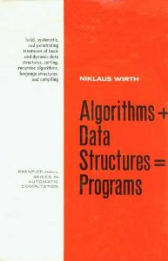



Data Structures – The Pep Talk
Excellent tool for learning problem solving skills
Constitute the core of software engineering
“Algorithms + Data Structures = Programs” - Niklaus Wirth
To solve a problem
Create the right data model
Devise the appropriate methods
Usual focus of coding interviews
Tencent Alibaba

Slide 17
Composing Large Strings

Slide 18
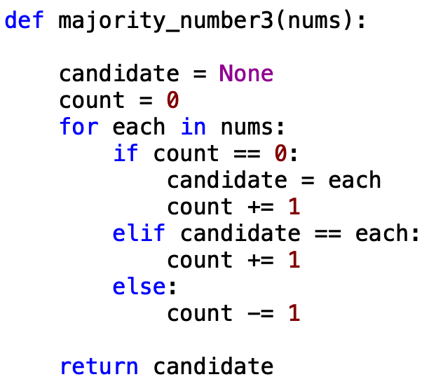
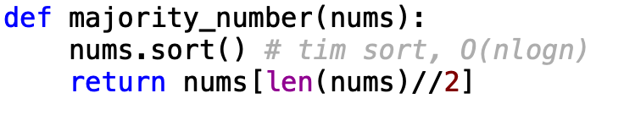
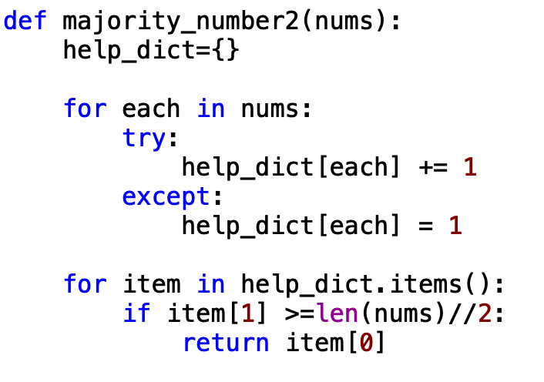
Majority Number
Given a list of size n, find the majority element. The majority element is the element that appears more than ⌊ n/2 ⌋ times.

Slide 19
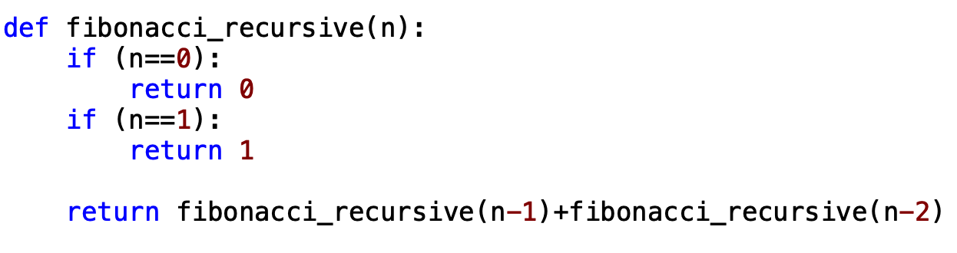
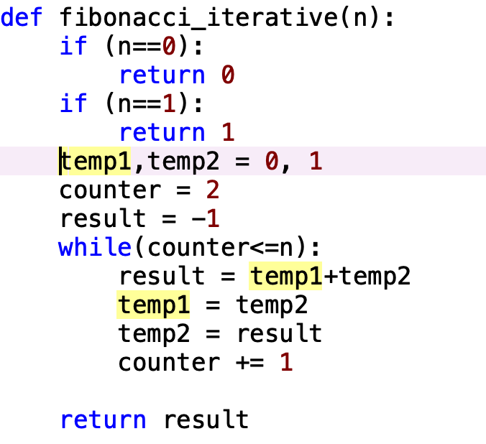
n-th Fibonacci Number
Notes:
Use the previous 2 numbers to create a new number

Slide 20
Jargon 101
Algorithm
Method for solving a problem
Searching, filtering, updating, adding/deleting, combining and so on.
Data Structure
Method for storing information
Representation and organization of data for efficient usage

Slide 21
Digital Data

Slide 22
Representing Data

Slide 23
Application examples
Web Information retrieval
Geographic Information Systems
Data Mining
Computational Biology
IP Routing Tables
Data Encryption
Data Structures for Databases
Floorplan Representation in VLSI
Image Data Structures

Slide 24
Data Types
Basic data types: booleans, bytes, integers, floats...
Simple abstractions
List/Array, String
More complex data types
Stacks, Trees, Sets, Graphs

Slide 25
Abstract Data Types (ADTs)
A collection of data with a set of operations
An ADT specification does not mention how operations are implemented
Example: ADT Set might provide add, remove, contains, union, and intersection operations

Slide 26
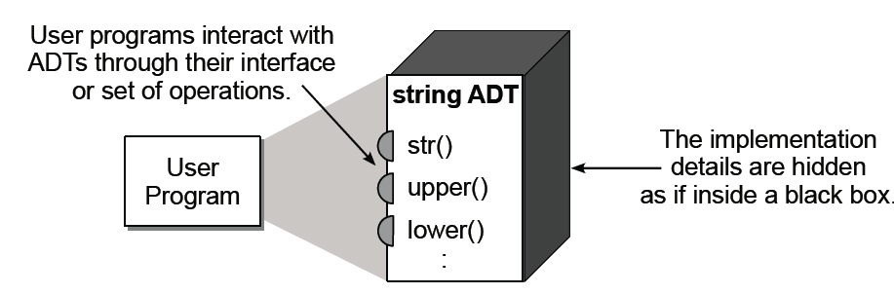
Abstract Data Types (ADTs)

Slide 27
ADTs vs. Data Structures
An abstract data type is a well-defined collection of data with a well-defined set of operations on it
A data structure is an actual implementation of a particular abstract data type
e.g. One can choose array or binary tree to store data for a string class
We want to have an efficient implementation to meet the requirement

Slide 28
Prerequisites (Python Experts???)
Design and implement complete programs in Python, including the use of modules and namespaces
Apply the basic data types and constructs, including loops, selection statements, and subprograms (functions)
Create and use the built-in list and dictionary structures
Design and implement basics of classes, including the use of helper methods and private attributes

